Slide 1
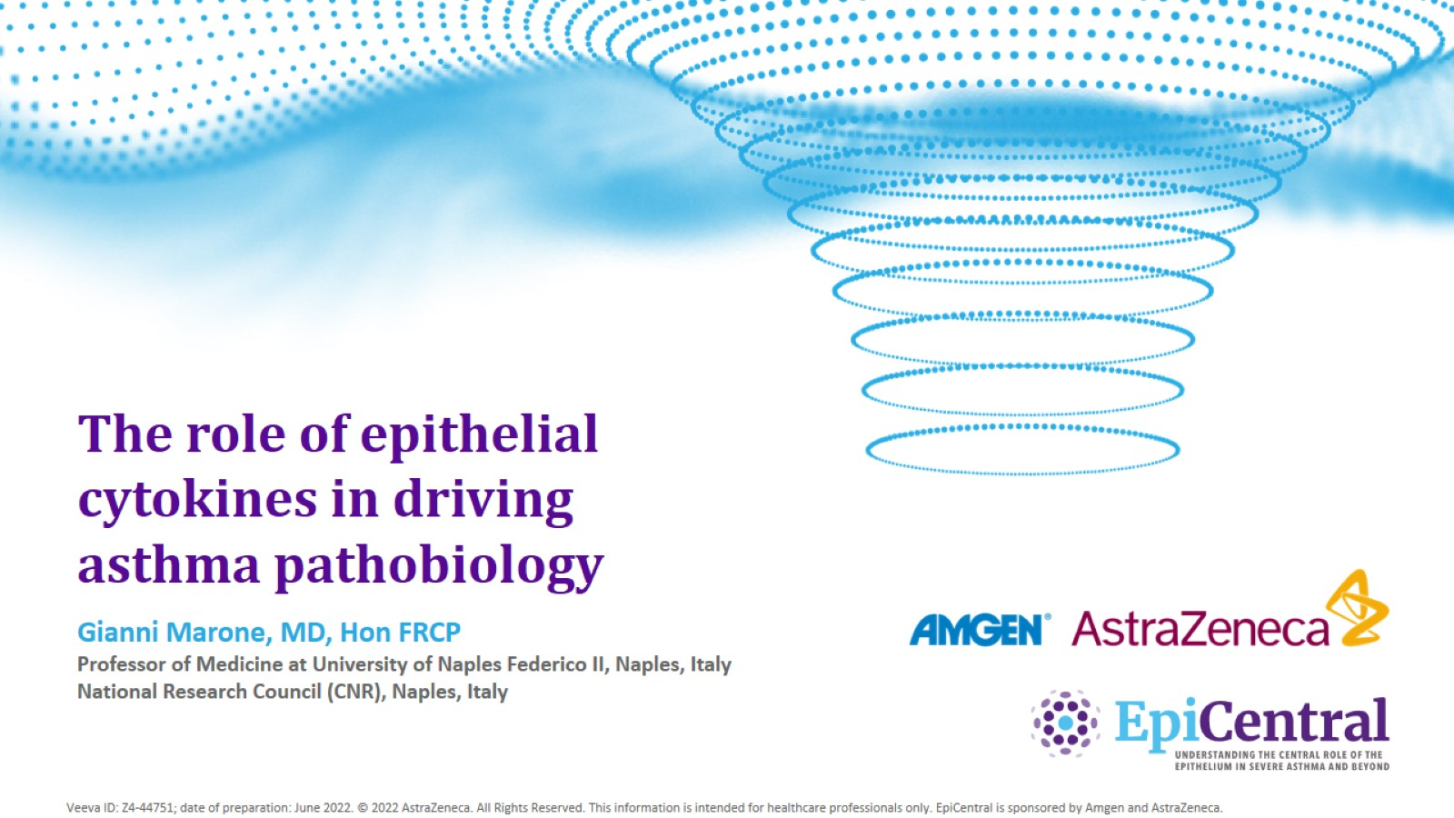
The role of epithelial cytokines in driving asthma pathobiology
CN-142721; date of preparation: Dec 2024. © 2025 AstraZeneca. All Rights Reserved. This information is intended for healthcare professionals only. EpiCentral is sponsored and developed by Amgen and AstraZeneca.

Slide 2
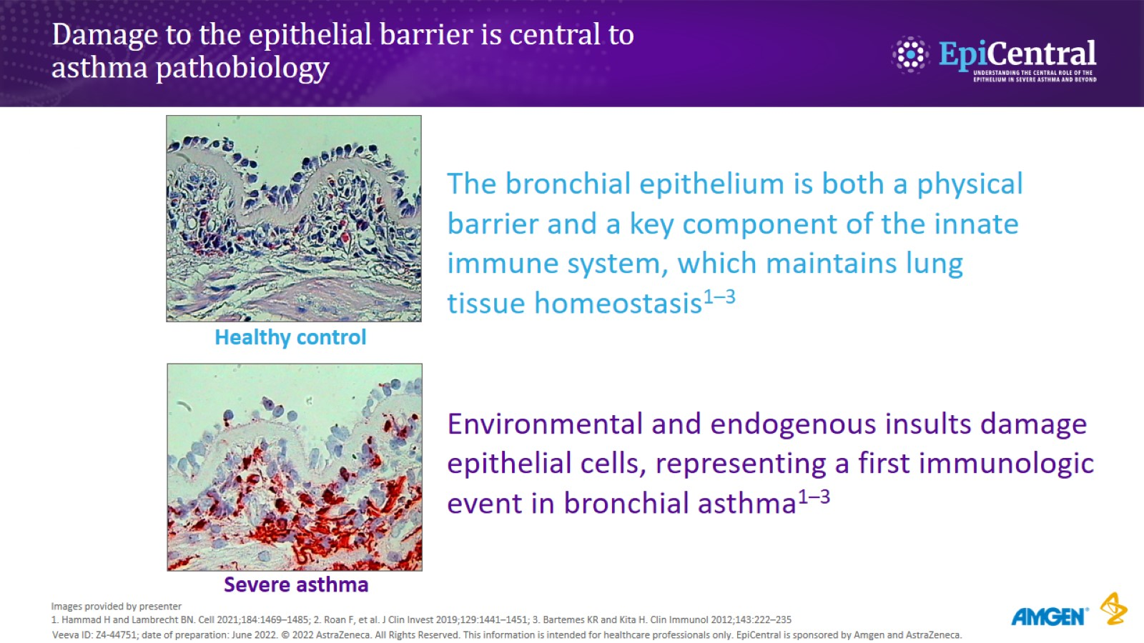
Damage to the epithelial barrier is central to asthma pathobiology
CN-142721; date of preparation: Dec 2024. © 2025 AstraZeneca. All Rights Reserved. This information is intended for healthcare professionals only. EpiCentral is sponsored and developed by Amgen and AstraZeneca.

Slide 3
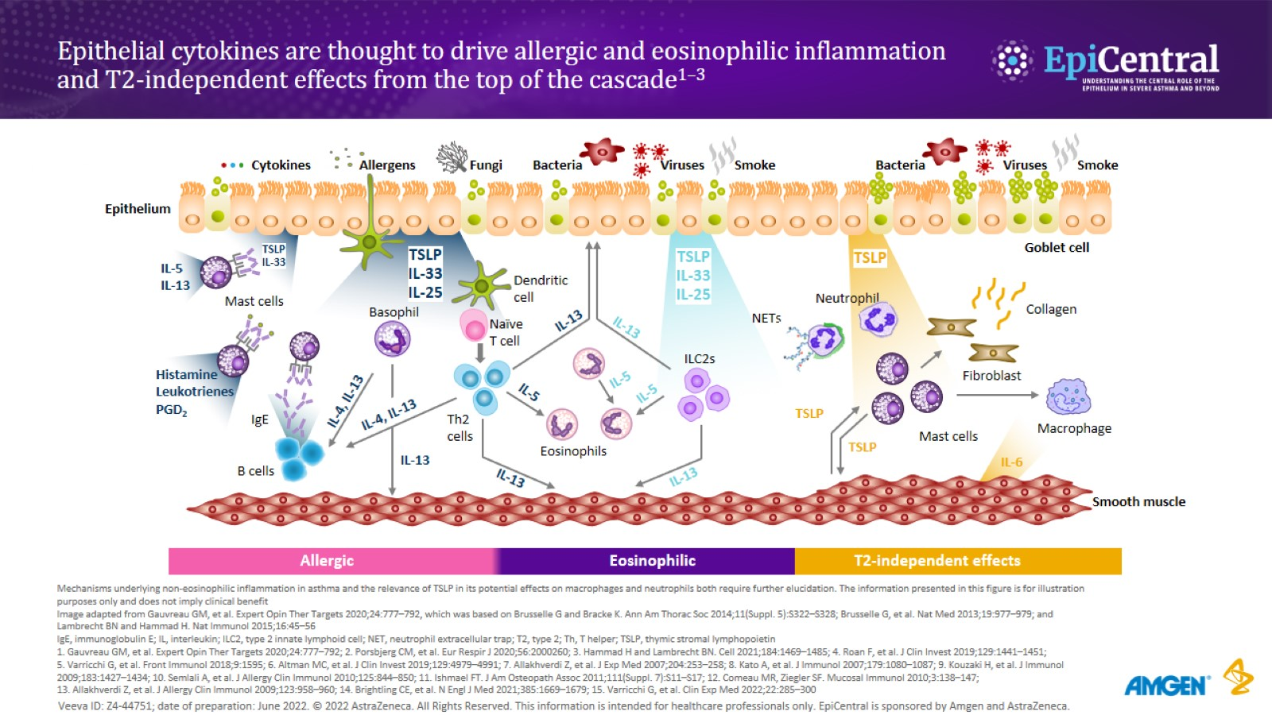
Epithelial cytokines are thought to drive allergic and eosinophilic inflammation and T2-independent effects from the top of the cascade^{1–3}
CN-142721; date of preparation: Dec 2024. © 2025 AstraZeneca. All Rights Reserved. This information is intended for healthcare professionals only. EpiCentral is sponsored and developed by Amgen and AstraZeneca.

Slide 4
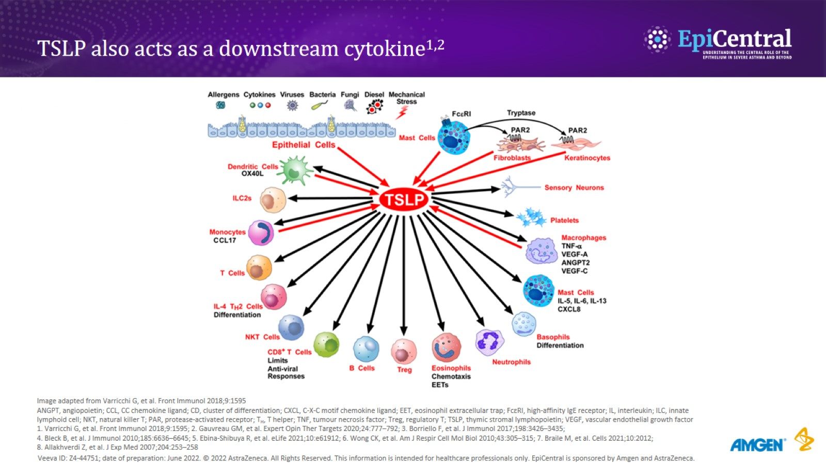
TSLP also acts as a downstream cytokine^{1,2}
CN-142721; date of preparation: Dec 2024. © 2025 AstraZeneca. All Rights Reserved. This information is intended for healthcare professionals only. EpiCentral is sponsored and developed by Amgen and AstraZeneca.

Slide 5
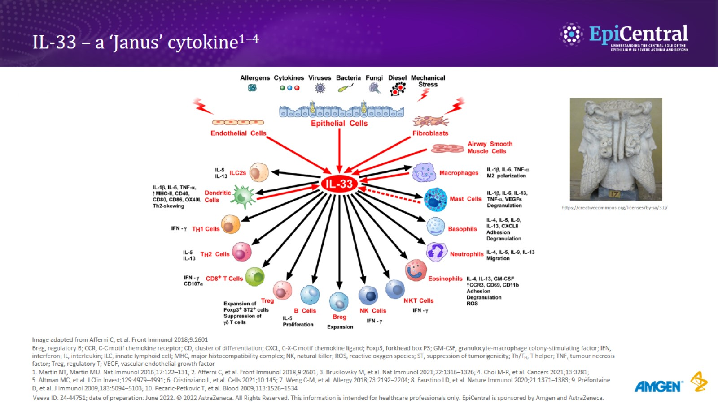
IL-33 – a ‘Janus’ cytokine^{1–4}
CN-142721; date of preparation: Dec 2024. © 2025 AstraZeneca. All Rights Reserved. This information is intended for healthcare professionals only. EpiCentral is sponsored and developed by Amgen and AstraZeneca.

Slide 6
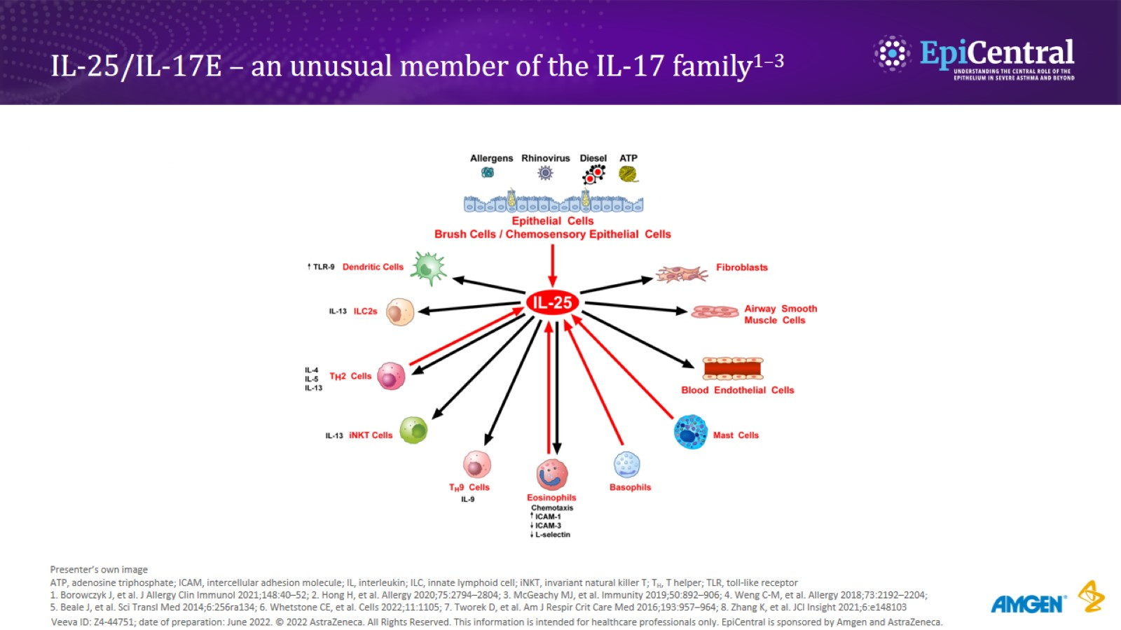
IL-25/IL-17E – an unusual member of the IL-17 family^{1–3}
CN-142721; date of preparation: Dec 2024. © 2025 AstraZeneca. All Rights Reserved. This information is intended for healthcare professionals only. EpiCentral is sponsored and developed by Amgen and AstraZeneca.

Slide 7
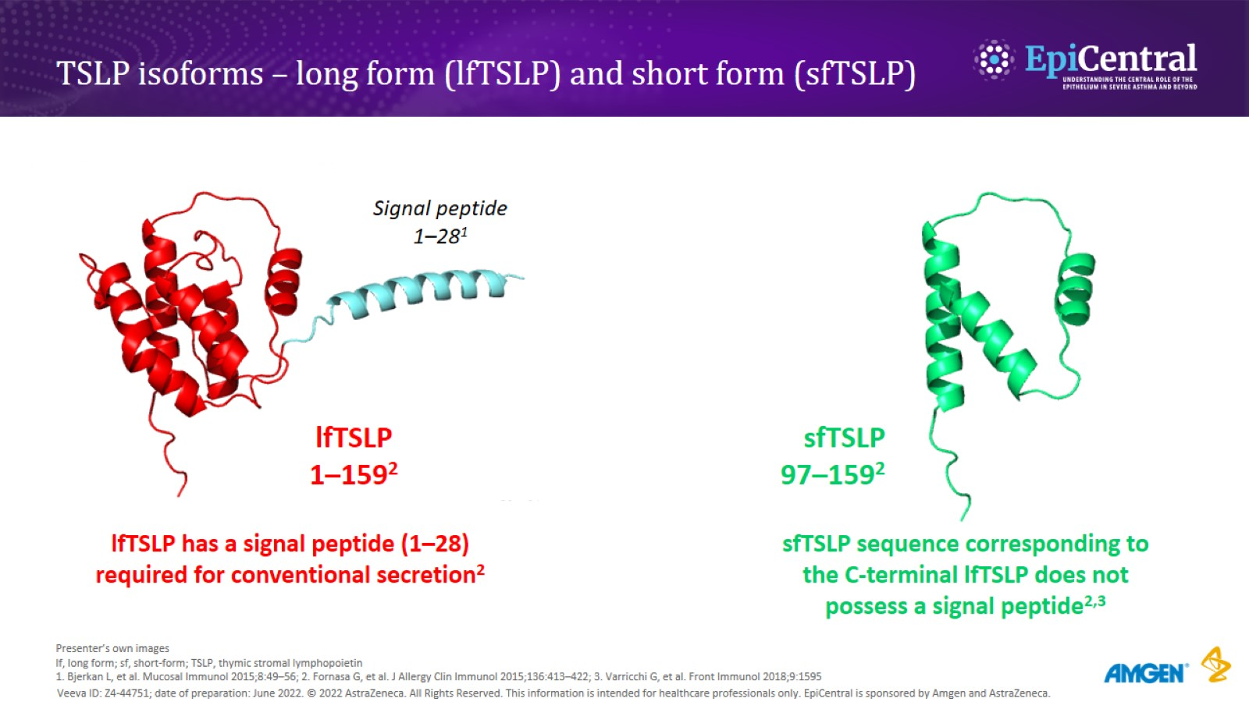
TSLP isoforms – long form (lfTSLP) and short form (sfTSLP)
CN-142721; date of preparation: Dec 2024. © 2025 AstraZeneca. All Rights Reserved. This information is intended for healthcare professionals only. EpiCentral is sponsored and developed by Amgen and AstraZeneca.

Slide 8
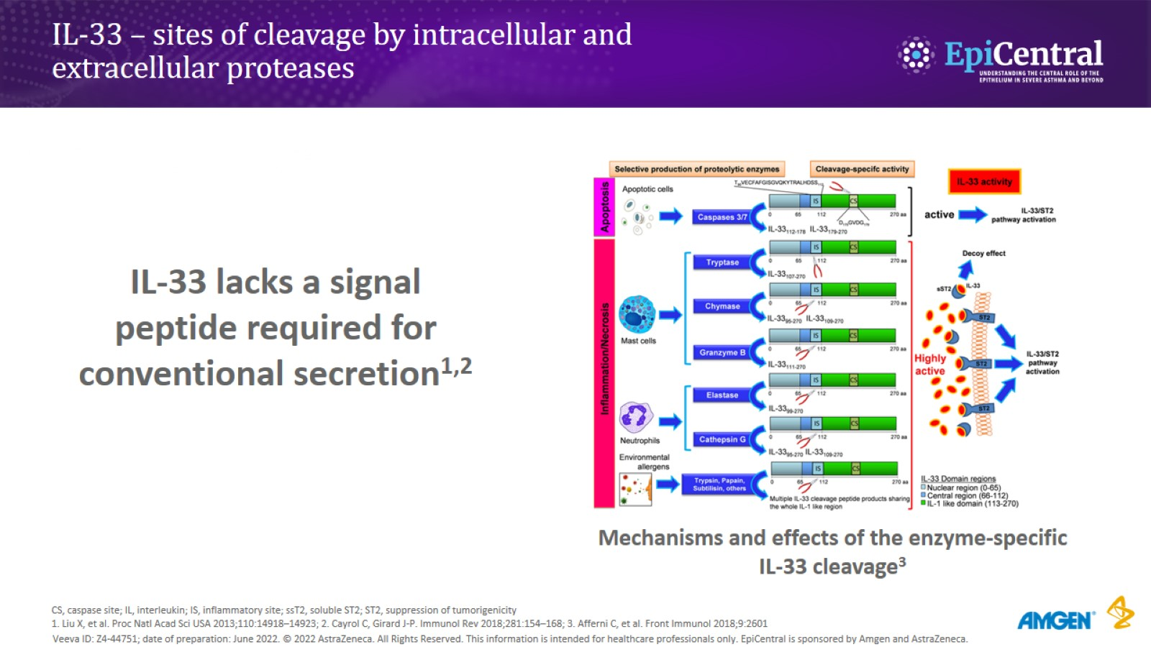
IL-33 – sites of cleavage by intracellular and extracellular proteases
CN-142721; date of preparation: Dec 2024. © 2025 AstraZeneca. All Rights Reserved. This information is intended for healthcare professionals only. EpiCentral is sponsored and developed by Amgen and AstraZeneca.

Slide 9
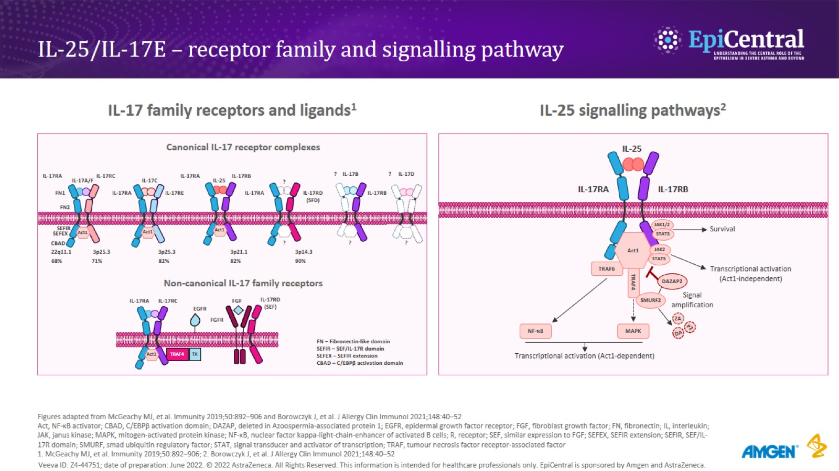
IL-25/IL-17E – receptor family and signalling pathway
CN-142721; date of preparation: Dec 2024. © 2025 AstraZeneca. All Rights Reserved. This information is intended for healthcare professionals only. EpiCentral is sponsored and developed by Amgen and AstraZeneca.

Slide 10
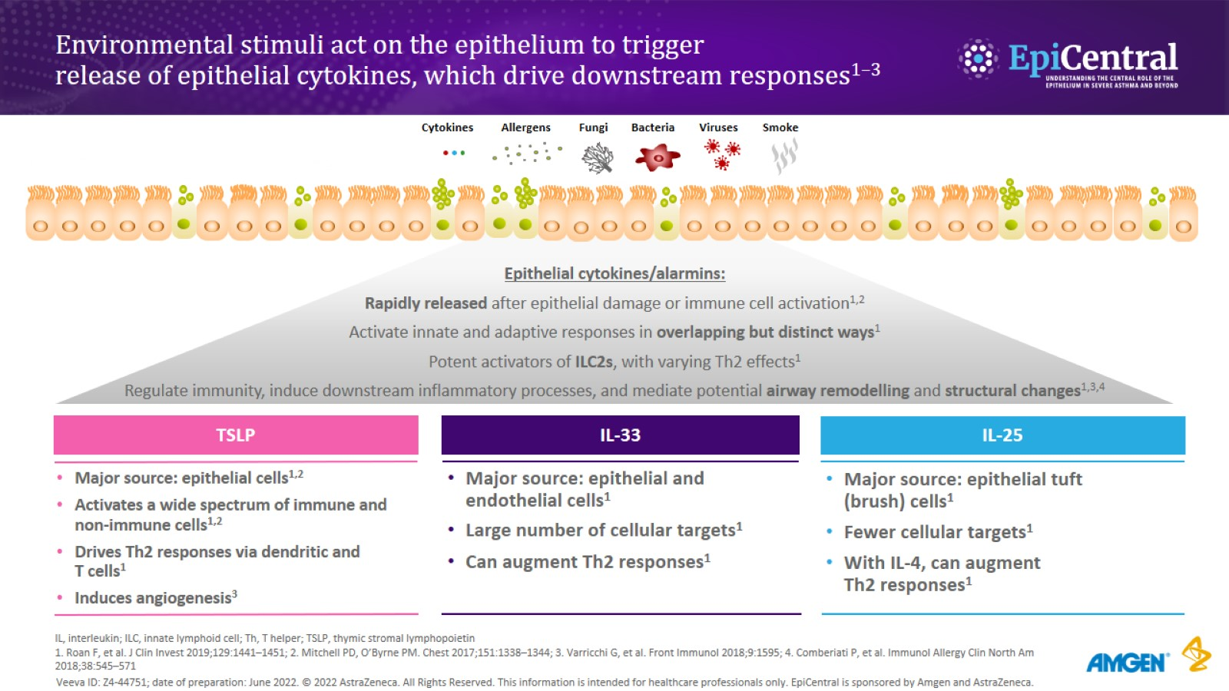
Environmental stimuli act on the epithelium to trigger release of epithelial cytokines, which drive downstream responses^{1–3}
CN-142721; date of preparation: Dec 2024. © 2025 AstraZeneca. All Rights Reserved. This information is intended for healthcare professionals only. EpiCentral is sponsored and developed by Amgen and AstraZeneca.

Slide 11
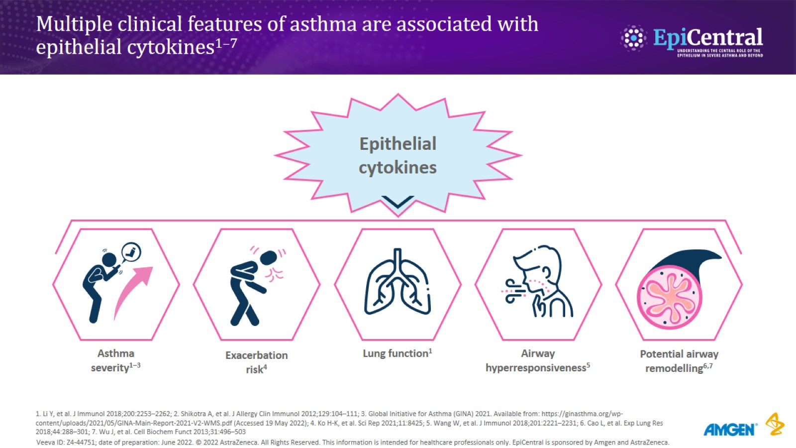
Multiple clinical features of asthma are associated with epithelial cytokines^{1–7}
CN-142721; date of preparation: Dec 2024. © 2025 AstraZeneca. All Rights Reserved. This information is intended for healthcare professionals only. EpiCentral is sponsored and developed by Amgen and AstraZeneca.

Slide 12
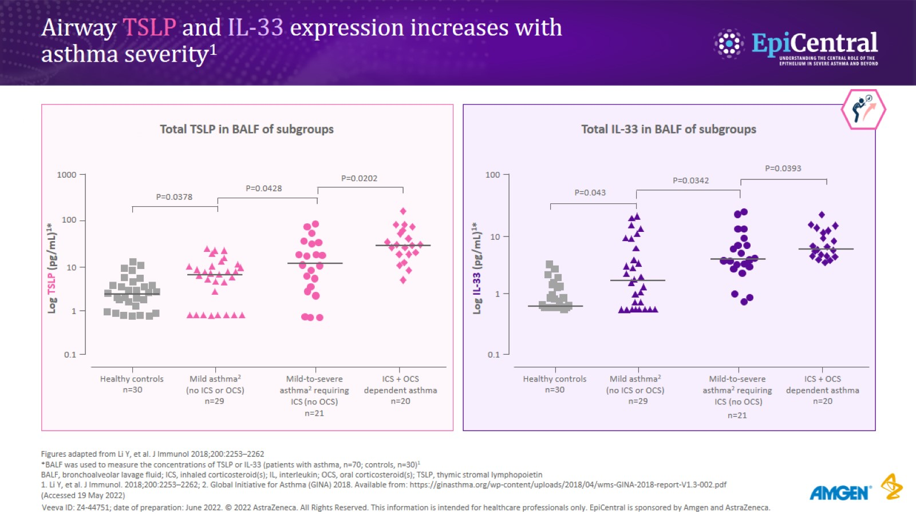
Airway TSLP and IL-33 expression increases with asthma severity¹
CN-142721; date of preparation: Dec 2024. © 2025 AstraZeneca. All Rights Reserved. This information is intended for healthcare professionals only. EpiCentral is sponsored and developed by Amgen and AstraZeneca.

Slide 13
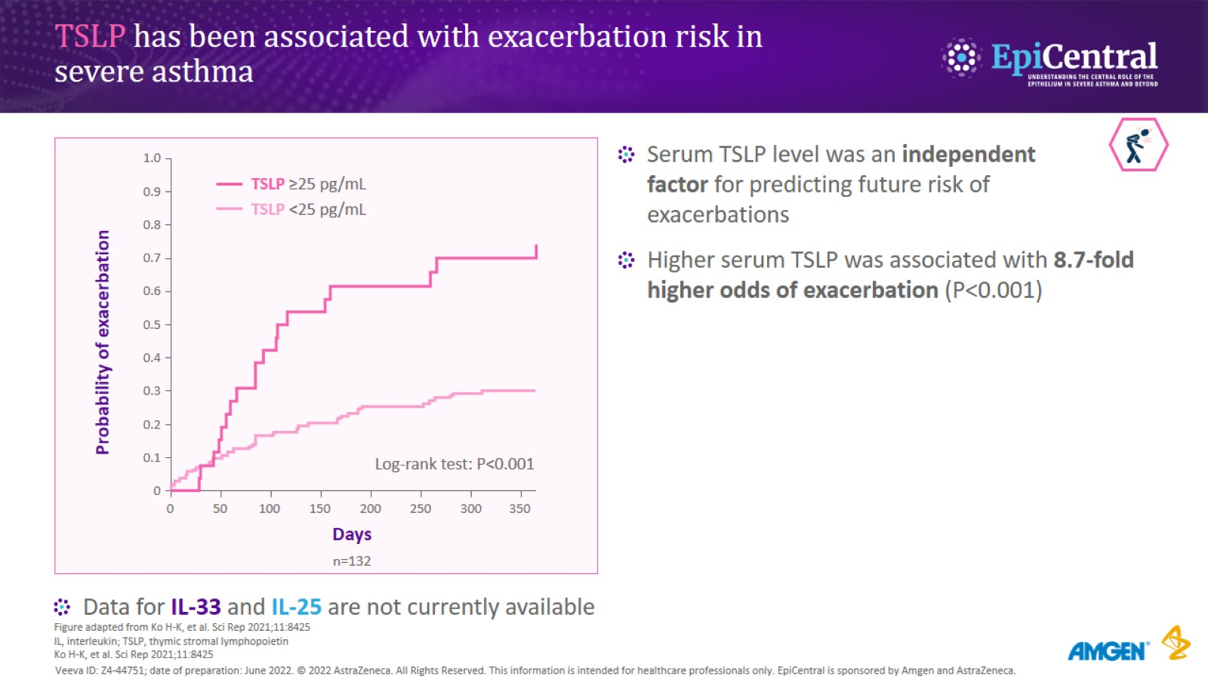
TSLP has been associated with exacerbation risk in severe asthma
CN-142721; date of preparation: Dec 2024. © 2025 AstraZeneca. All Rights Reserved. This information is intended for healthcare professionals only. EpiCentral is sponsored and developed by Amgen and AstraZeneca.

Slide 14
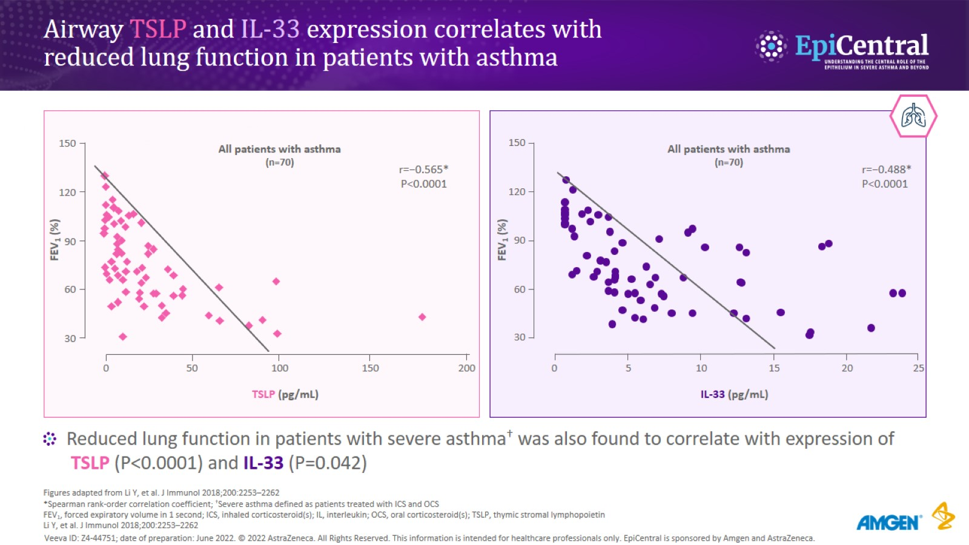
Airway TSLP and IL-33 expression correlates with reduced lung function in patients with asthma
CN-142721; date of preparation: Dec 2024. © 2025 AstraZeneca. All Rights Reserved. This information is intended for healthcare professionals only. EpiCentral is sponsored and developed by Amgen and AstraZeneca.

Slide 15
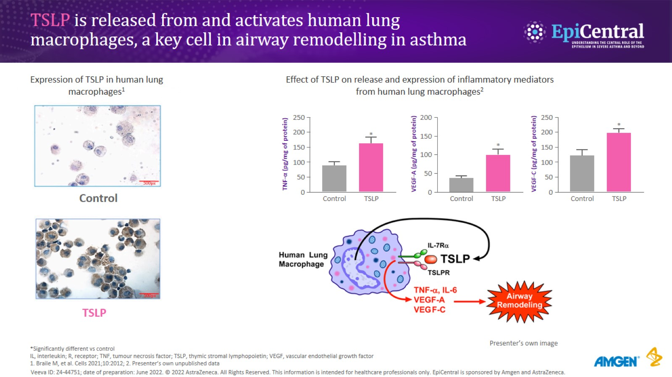
TSLP is released from and activates human lung macrophages, a key cell in airway remodelling in asthma
CN-142721; date of preparation: Dec 2024. © 2025 AstraZeneca. All Rights Reserved. This information is intended for healthcare professionals only. EpiCentral is sponsored and developed by Amgen and AstraZeneca.

Slide 16
Multiple clinical features of asthma are associated with epithelial cytokines^{1–7}
CN-142721; date of preparation: Dec 2024. © 2025 AstraZeneca. All Rights Reserved. This information is intended for healthcare professionals only. EpiCentral is sponsored and developed by Amgen and AstraZeneca.

Slide 17

Thank you for your kind attention
CN-142721; date of preparation: Dec 2024. © 2025 AstraZeneca. All Rights Reserved. This information is intended for healthcare professionals only. EpiCentral is sponsored and developed by Amgen and AstraZeneca.

